Slide 1
Retrieval Augmented Generation with Vectors
Amy Wong, Coby Tung, Jungwoo Park

Slide 2
Large Language Models
Large Language Models are pretrained sets of data that uses probabilities to predict the way people naturally speak. They may use:
Large datasets
Neural Networks
Transformers
To simulate normal speech

Slide 3
Why go for R.A.G ?
As LLMs base their result off probabilities, they are prone to make errors.
According to AWS:
Known challenges of LLMs include:
Presenting false information when it does not have the answer.
Presenting out-of-date or generic information when the user expects a specific, current response.
Creating a response from non-authoritative sources.
Creating inaccurate responses due to terminology confusion, wherein different training sources use the same terminology to talk about different things.

Slide 4
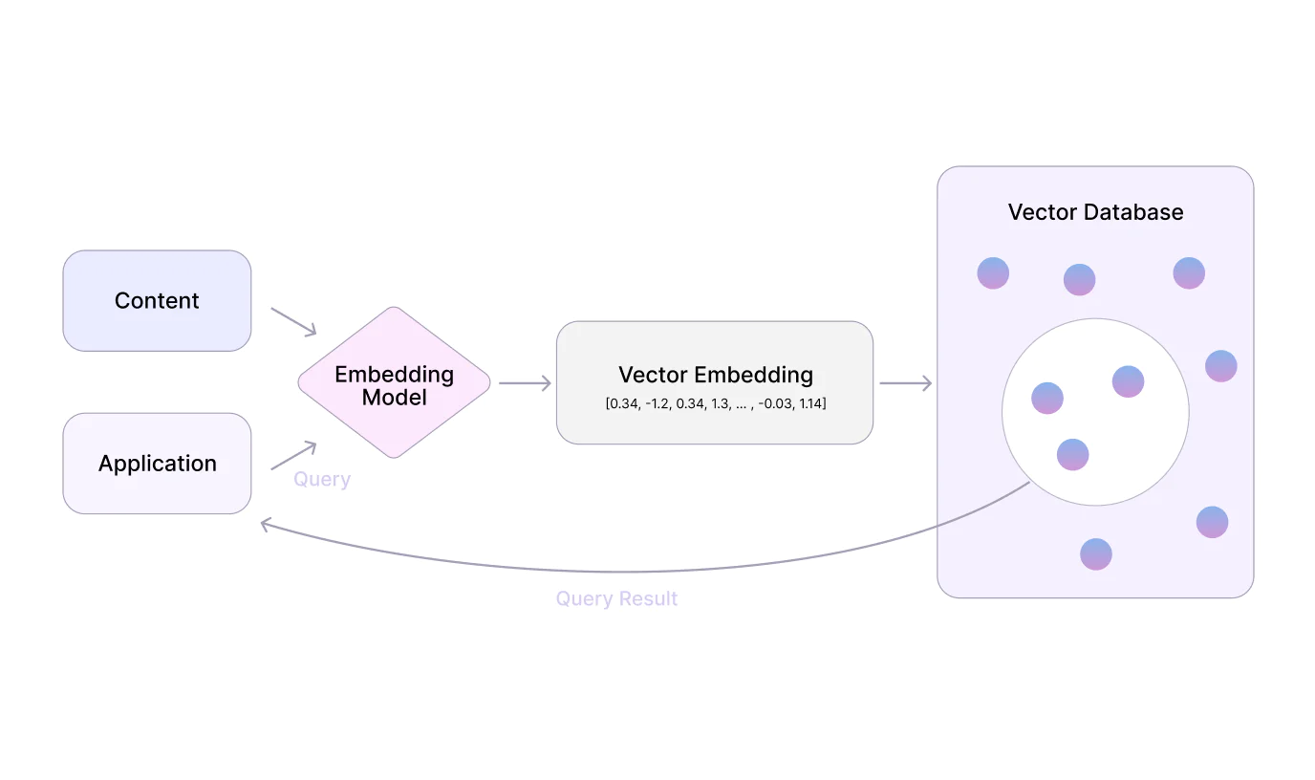
Vectors
Notes:
Img source: https://devtorium.com/blog/how-vector-databases-can-enhance-custom-ai-solutions/
Talking points:
By using vector embedding, we won’t have to retrain the whole AI model again (saves time)
Doesn’t need the AI to learn incredibly focused/niche knowledge (saves space)

Slide 5
Creating the Vector Database
Initially we used a PDF with a recent scientific study, as we thought it would be a good piece of unstructured data that is
Niche
Very recent
This way, the LLM should not previously have known such information, and this allows us to test properly.

Slide 6
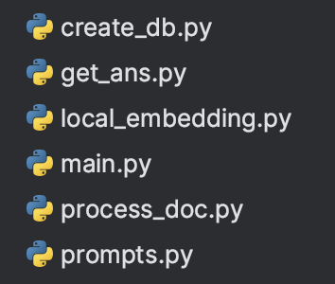
Files

Slide 7
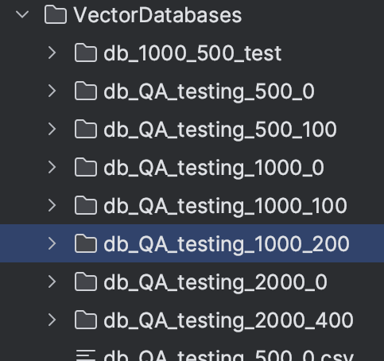
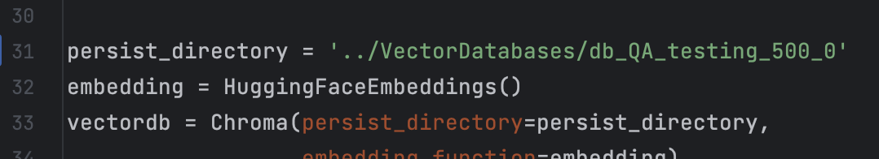
Retriever
After the Vector Database is set up, a retriever would then use that database to try and generate text based on the PDF.
The database you use can be changed in this line of code:

Slide 8
Example:
Without using any database:
Using a vector database:

Slide 9
Observations
Chunk Size | Chunk Overlap | Time to create DB
500 | 100 | 1m 12s
500 | 200 | 2m 33s
1000 | 200 | 1m 50s
1000 | 500 | 1m 46s
1000 | 750 | 2m 48s
2000 | 400 | 49s
2000 | 1000 | 1m 42s
4000 | 1000 | 22.8s

Slide 10
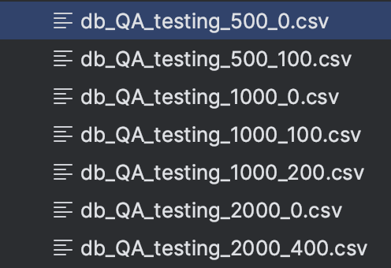
Observations
Additionally, we also recorded the tests using different databases to see how chunk size and chunk overlap can change the results.
Also for this test, we experimented with some different ways of asking the chatbot to see if it can give better replies (or at least, give a reply based on how we wanted it to answer)
https://drive.google.com/drive/u/0/folders/1R3A4fHQQj_th1a6gMK8zf9-dAAqJqtKV

Slide 11
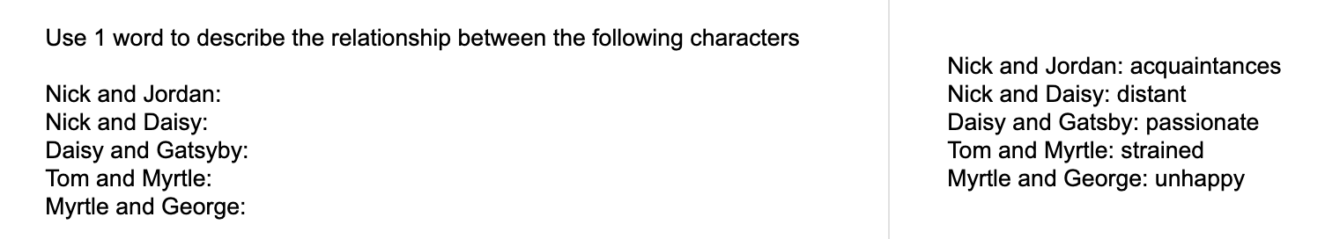
Examples

